Slide 1
Creating Multidimensional
DRA
INGS
With Epicycles
Jan Philipp Birmanns Supervised by Nicoletta Ravizza-Andri
Notes:
1

Slide 2
Epicycles
Notes:
2

Slide 3
Epicycles
Notes:
This motion can lead to the planet taking various interesting paths *-‘*such as presented here.
The famous astronomer Ptolemy used this idea in his geocentric model of our solar system. Epicycles were utilized to explain the phenomenon of retrograde motion that many extra celestial bodies such as Mars present. It is well known today that our solar system is in fact heliocentric, implying that all these theories must be false. Nonetheless, Ptolemy’s model precisely matches all the observations that he made from Earth. Unbeknownst to him this was because it is possible to trace any path through the help of epicycles as long as one chains enough of these circular orbits together. This property can be taken advantage of to trace specific paths such as was done in this project.
Before this is discussed more precisely, I will introduce an alternative interpretation of epicycles.
3

Slide 4
Epicycles
Notes:
Before we move on, a precise definition of the term “epicycle” must be established. The word stems from ancient astronomy and *->* describes the motion of a planet, which is shown as a black dot here, that moves on a circle *->* which itself is being carried along the circumference of a larger circle *->*. This motion can lead to the planet taking various interesting paths *-‘*such as presented here.
4

Slide 5
Fourier Transform
+
+

Slide 6
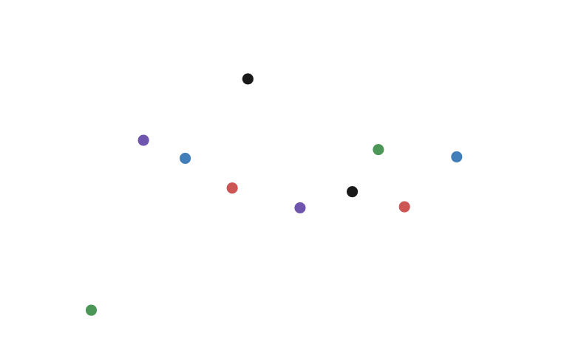
Discrete Fourier Transform
+
+

Slide 7
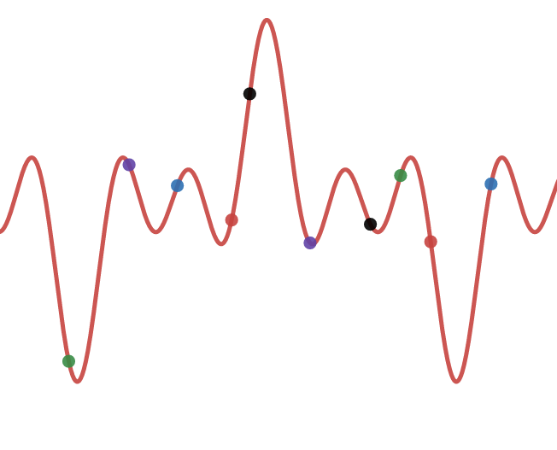
Discrete Fourier Transform
+
+

Slide 8
Inverse Discrete Fourier Transform
$$x\left(k\right)=\frac{1}{N}\sum_{n=0}^{N−1}{X_{n}}e^{i⋅2π⋅n⋅k\frac{1}{N}}$$
$$x\left(k\right)=\frac{1}{N}X_{0}e^{i⋅2π⋅0⋅k\frac{1}{N}}+\frac{1}{N}X_{1}e^{i⋅2π⋅1⋅k\frac{1}{N}}+\frac{1}{N}X_{2}e^{i⋅2π⋅2⋅k\frac{1}{N}}+…$$

Slide 9
Inverse Discrete Fourier Transform
$$\frac{1}{N}X_{n}e^{i⋅2π⋅n⋅k\frac{1}{N}}$$
$$\frac{1}{N}X_{n}\left(cos\left(2π⋅n⋅k\frac{1}{N}\right)+i⋅sin\left(2π⋅n⋅k\frac{1}{N}\right)\right)$$

Slide 10
Inverse Discrete Fourier Transform
$$x\left(k\right)=\frac{1}{N}X_{0}e^{i⋅2π⋅0⋅k\frac{1}{N}}+\frac{1}{N}X_{1}e^{i⋅2π⋅1⋅k\frac{1}{N}}+\frac{1}{N}X_{2}e^{i⋅2π⋅2⋅k\frac{1}{N}}+…$$
$$ℜx\left(k\right)=\frac{1}{N}X_{0}cos\left(2π⋅0⋅k\frac{1}{N}\right)+\frac{1}{N}X_{1}cos\left(2π⋅1⋅k\frac{1}{N}\right)+\frac{1}{N}X_{2}cos\left(2π⋅2⋅k\frac{1}{N}\right)+…$$

Slide 11
Inverse Discrete Fourier Transform
$$\frac{1}{N}X_{n}\left(cos\left(k\frac{2π⋅n}{N}\right)+i⋅sin\left(k\frac{2π⋅n}{N}\right)\right)$$
$$P\left(\frac{X_{n}}{N}cos\left(ω\right),\frac{X_{n}}{N}sin\left(ω\right)\right)$$
$$θ$$
$$ω=k\frac{2π⋅n}{N}$$
$$θ = tan\left(\frac{ℑX_{n}}{ℜX_{n}}\right)$$
$${\left|X_{n}\right|}/N$$

Slide 12
Inverse Discrete Fourier Transform
$$\frac{1}{N}X_{n}\left(cos\left(k\frac{2π⋅n}{N}\right)+i⋅sin\left(k\frac{2π⋅n}{N}\right)\right)$$
$$φ$$
$$P\left(\frac{X_{n}}{N}cos\left(ω\right),\frac{X_{n}}{N}sin\left(ω\right)\right)$$
$$θ$$
$$ω=k\frac{2π⋅n}{N}$$
$$θ = tan\left(\frac{ℑX_{n}}{ℜX_{n}}\right)$$
$${\left|X_{n}\right|}/N$$
$$φ = k\frac{2π⋅n}{N}$$

Slide 13
Inverse Discrete Fourier Transform
$$\frac{1}{N}X_{n}\left(cos\left(k\frac{2π⋅n}{N}\right)+i⋅sin\left(k\frac{2π⋅n}{N}\right)\right)$$
$$P\left(\frac{X_{n}}{N}cos\left(ω\right),\frac{X_{n}}{N}sin\left(ω\right)\right)$$
$$ω=k\frac{2π⋅n}{N}$$
$$θ = tan\left(\frac{ℑX_{n}}{ℜX_{n}}\right)$$
$$φ = k\frac{2π⋅n}{N}$$

Slide 14
Inverse Discrete Fourier Transform
$$x\left(k\right)=\frac{1}{N}X_{0}e^{i⋅2π⋅0⋅k\frac{1}{N}}+\frac{1}{N}X_{1}e^{i⋅2π⋅1⋅k\frac{1}{N}}+\frac{1}{N}X_{2}e^{i⋅2π⋅2⋅k\frac{1}{N}}+…$$
$$x\left(k\right)=$$
$$+$$
$$+$$
$$+…$$

Slide 15
dft.birmanns.org

Slide 16
Expanding to Higher Dimensions
$$c=a+bi$$
$$q=a+bi+cj+dk$$
Discrete Quaternion Fourier Transform
Discrete Fourier Transform

Slide 17
Inverse Discrete Quaternion Fourier Transform
$$x\left(f\right)=\sum_{n=0}^{N−1}{e^{−μ2πnf\frac{1}{N}}}X_{n}$$
$$μ=i$$
$$\begin{aligned}e^{−ω ⋅i}X_{n}=\left(cos\left(ω\right)a−sin\left(ω\right)b\right)+i\left(cos\left(ω\right)b+sin\left(ω\right)a\right) \\ +j\left(cos\left(ω\right)c−sin\left(ω\right)d\right)+k\left(cos\left(ω\right)d+sin\left(ω\right)c\right)\end{aligned}$$
$$X_{n}=a+bi+cj+dk$$
$$ω=2πnf\frac{1}{N}$$
$$\left|e^{−ω ⋅i}X_{n}\right|=\sqrt[2]{a^{2}+b^{2}+c^{2}+d^{2}}$$

Slide 18
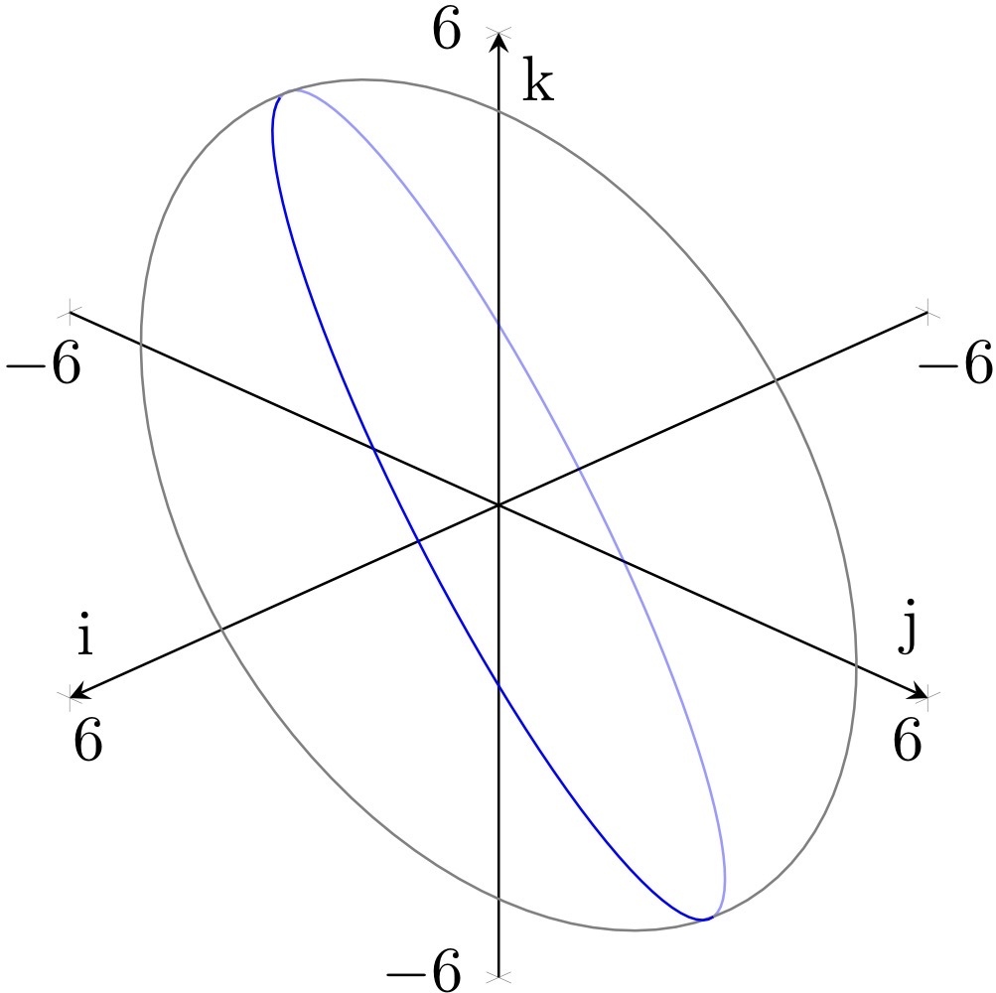
Inverse Discrete Quaternion Fourier Transform
$$\left(cos\left(ω\right)b+sin\left(ω\right)a\right)i+\left(c+di\right)\left(cos\left(ω\right)j+sin\left(ω\right)k\right)$$

Slide 19
dqft.birmanns.org

